Slide 1
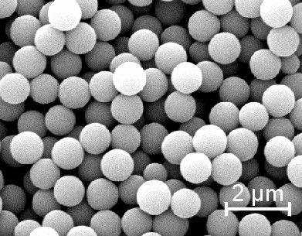
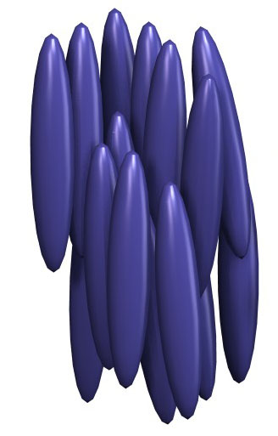
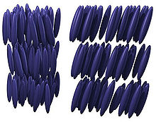
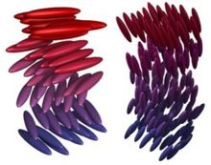
Colloidal Suspension
Liquid Crystals
nematic
smectic A
smectic C
chiral/cholesteric

Slide 2
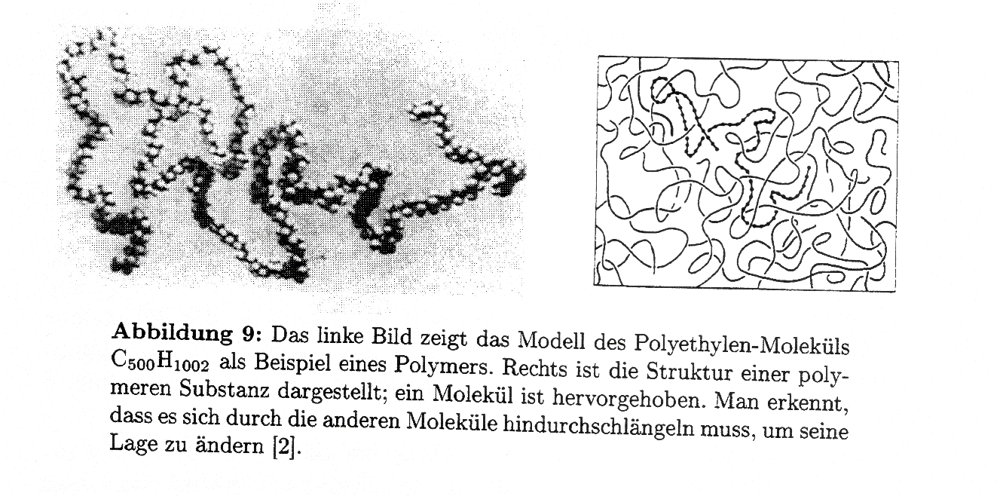
Polymers

Slide 3
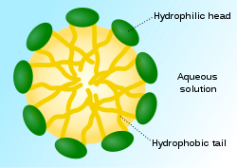
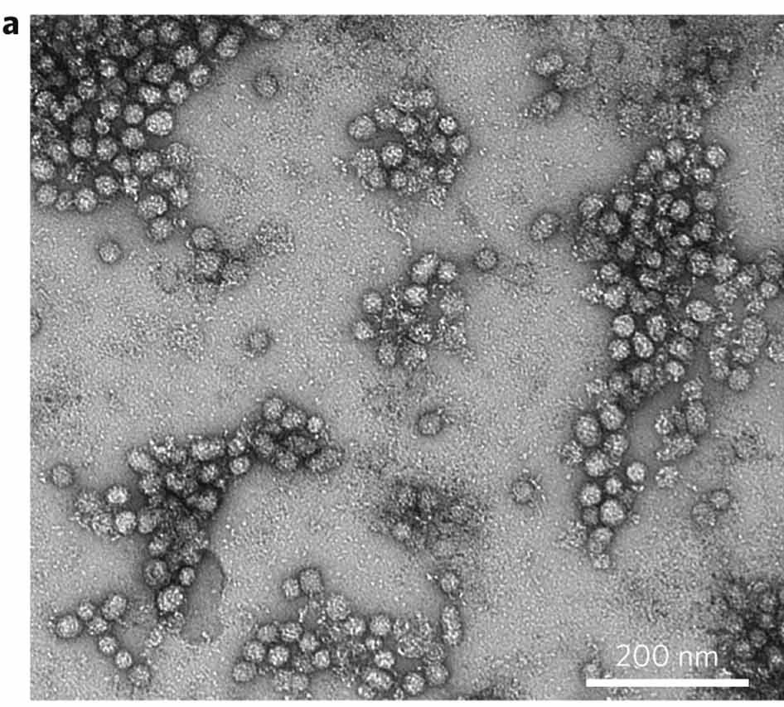
Micelles

Slide 4
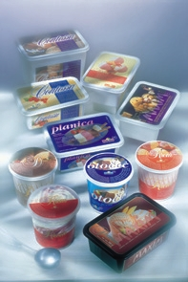
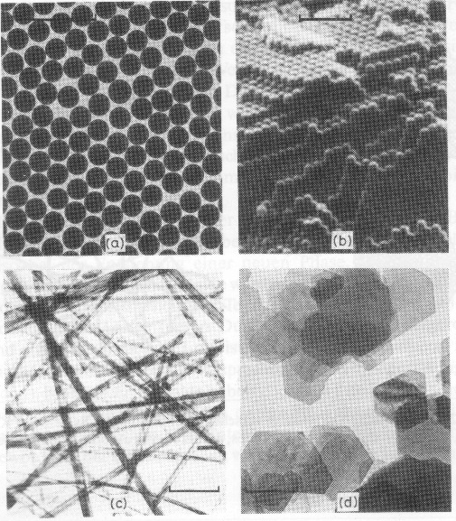
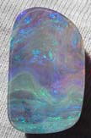
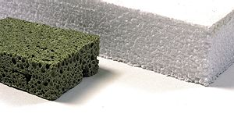
Klassifizierung kolloidaler Systeme
Beispiele | Klasse | Disperse Phase | Dispersionsmittel
Nebel, Dunst Tabakrauch, Aerosolsprays | Flüssige Aerosole | Flüssigkeit | Gas
Milch, Butter Mayonnaise, Asphalt Salben | Emulsionen | Flüssigkeit | Flüssigkeit
Anorganische Kolloide (z.B. Gold, PS, Silica) Farben, Lacke Zahnpasta | Suspension/Dispersion | Feststoff | Flüssigkeit
Schäume | Schaum | Gas | Flüssigkeit
Schaumstoffe, Ytong | Fester Schaum | Gas | Feststoff
Opal: regelmäßig angeordnete Silikatteilchen (3D Beugungsgitter)
→ schillernde Farben

Slide 5
Albert Einstein‘s most cited paper !!
On the Movement of Small Particles Suspended in Stationary Liquids Required by the Molecular-Kinetic Theory of Heat
This work will demonstrate that ... small objects which are suspended in a liquid will colloide with the liquid‘s molecules which leads to a motion which can be detected with a microscope ....

Slide 6
